Slide 1
The Limits to Growth: Sustainability and the Circular Economy
Lecture 7: Circular Economy
Prof. Dr. Benjamin Leiding
M.A. Theresa Sommer

Slide 2
License
This work is licensed under a Creative Commons Attribution-ShareAlike 4.0 International License. To view a copy of this license, please refer to https://creativecommons.org/licenses/by-sa/4.0/ .
Updated versions of these slides will be available in our Github repository.

Slide 3
News/Updates

Slide 4

Course Evaluation
Link: Click Me

Slide 5
ExerciseS E04 - E05

Slide 6
Exercise E04
National Sustainability Discourse
You chose articles and reported how sustainability is discussed in the following countries:
India
Ukraine
Russia
Saudi Arabia
Brazil
Germany

Slide 7
Exercise E04
National Sustainability Discourse
Country | Your Assessement | CCPI 2023
India | “Indian government considers sustainability to be an important national issue” “India has been giving importance to maintaining a sustainable environment” | Rank: 8 High Rating
Ukraine | “sustainability is a political priority of Ukraine since 2015” | Not ranked due to the war (2022: Rank: 20)
Russia | “I don't feel that sustainability is an important topic in society or in government“ “Speaking about Russia in general, sustainability is not a major political priority for now” | Rank 59 Very Low
Saudi Arabia | “Sustainability was not a political priority in Saudi Arabia, although in more recent times it has been aiming to be better involved in it, and has been trying to rebrand itself as a greener country” | Rank: 62 Very Low
Brazil | “Sustainability is a political priority to varying degrees” | Rank: 38 Low
Burck et al. (2022): Climate Change Performance Index 2023. https://ccpi.org/wp-content/uploads/CCPI-2023-Results-3.pdf

Slide 8
Exercise E05
Your Suggestions for Policy Actions
Industrialization:
“The most important thing for this scenario is probably to deliberately slow down the growth of industrialization. It is this sector that has the greatest impact on the amount of pollution and the amount of use of natural resources.”
Resources and Energy Sources:
“resort to more sustainable sources of resources, like renewable energy”
“We could invest heavily in research for new technologies to reduce pollution and use our resources more efficiently.”
“Better distribution of resources across the world”
“100 percent renewable energy without fossil or atomic energy”
Food Stability/ Poverty:
“We focus on the Food sector and trying to beat poverty and starvation”
“We could prohibit the consumption of meat.”

Slide 9
Introduction

Slide 10
Introduction
Sustainability – Definition
„Development that meets the needs of the present without compromising the ability of future generations to meet their own needs.”
Report of the World Commission on Environment and Development: Our Common Future (1987) – http://www.un-documents.net/our-common-future.pdf

Slide 11
Introduction
Sustainability – Implications
Sustainability → Consume less

Slide 12
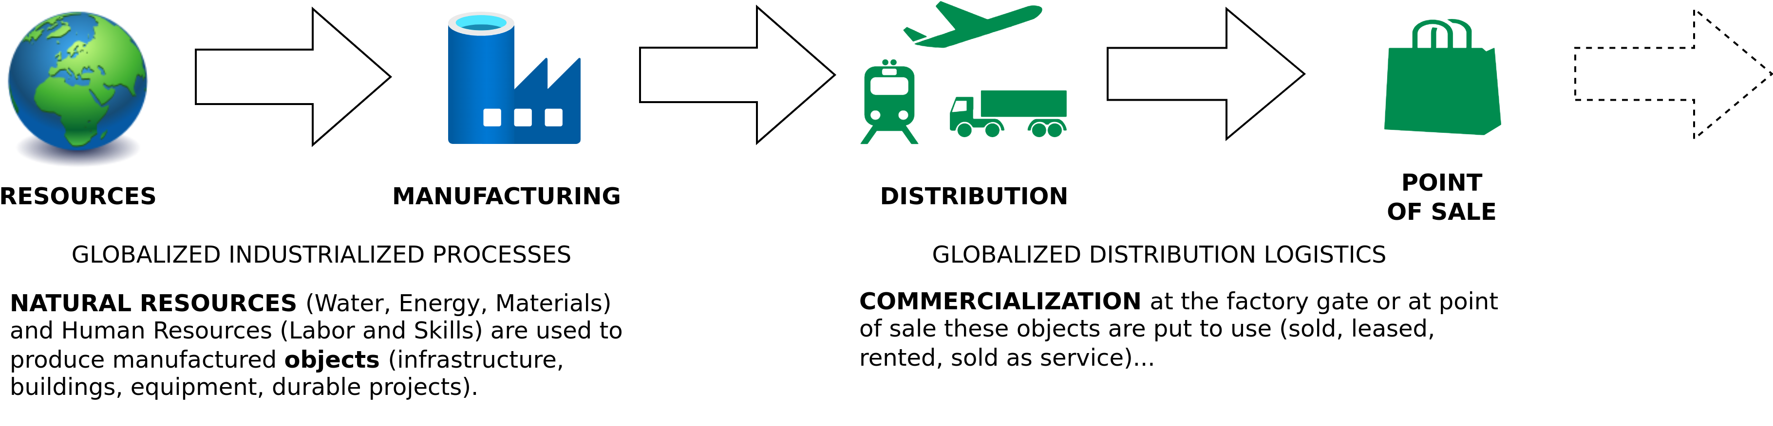
Introduction
Linear (Industrial) Economy
Image adapted from: Walter R. Stahel (2019) – The Circular Economy: A User’s Guide.

Slide 13
Introduction
Linear Economy
“Take – Make – Dispose”

Slide 14
Introduction
Linear Economy
“Take – Make – Dispose”

Slide 15
Introduction
Linear (Industrial) Economy – Definition
“Its objectives are to maintain value (not to create value added), to optimise stock management (not flows) and to increase the efficiency of using goods (not of producing goods)”
Walter R. Stahel (2019) – The Circular Economy: A User’s Guide.

Slide 16
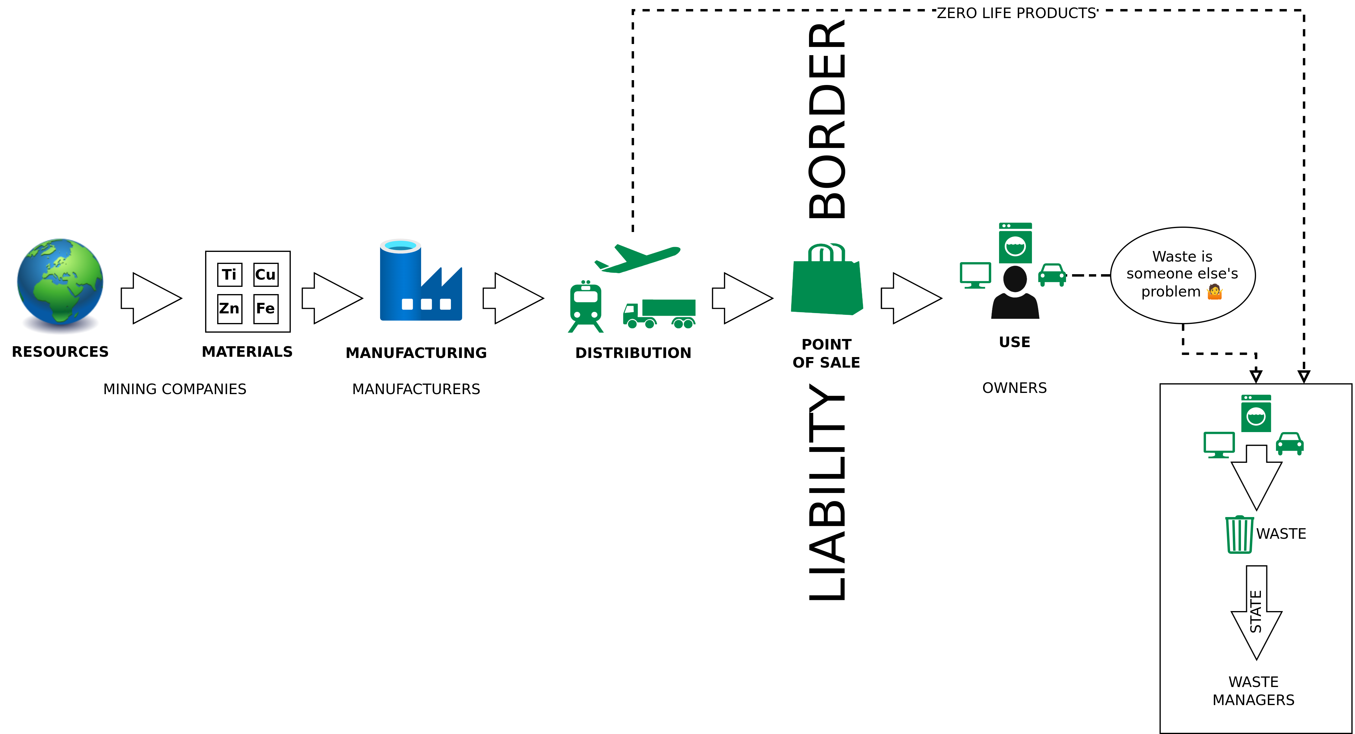
Introduction
Linear (Industrial) Economy – Waste Management as last Step
Image adapted from: Walter R. Stahel (2019) – The Circular Economy: A User’s Guide.

Slide 17
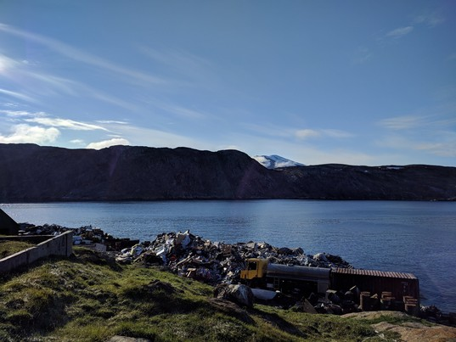
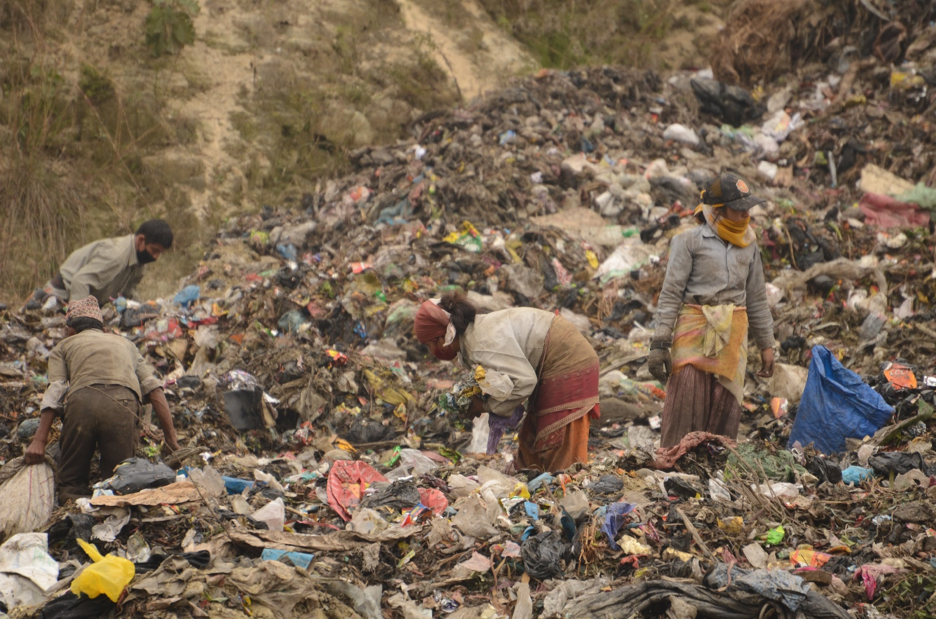
Introduction
Horrible Waste Management
1. "Landfill at Upernavik" by ulalume – https://www.flickr.com/photos/96649248@N00/43867280734 – CC BY-NC-ND 2.0.
2. Christian Hüpfer – https://flic.kr/p/aKXw2F – CC BY-SA 2.0.

Slide 18
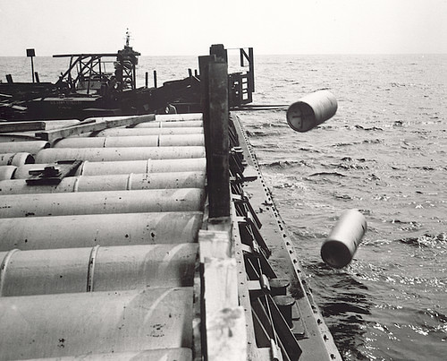
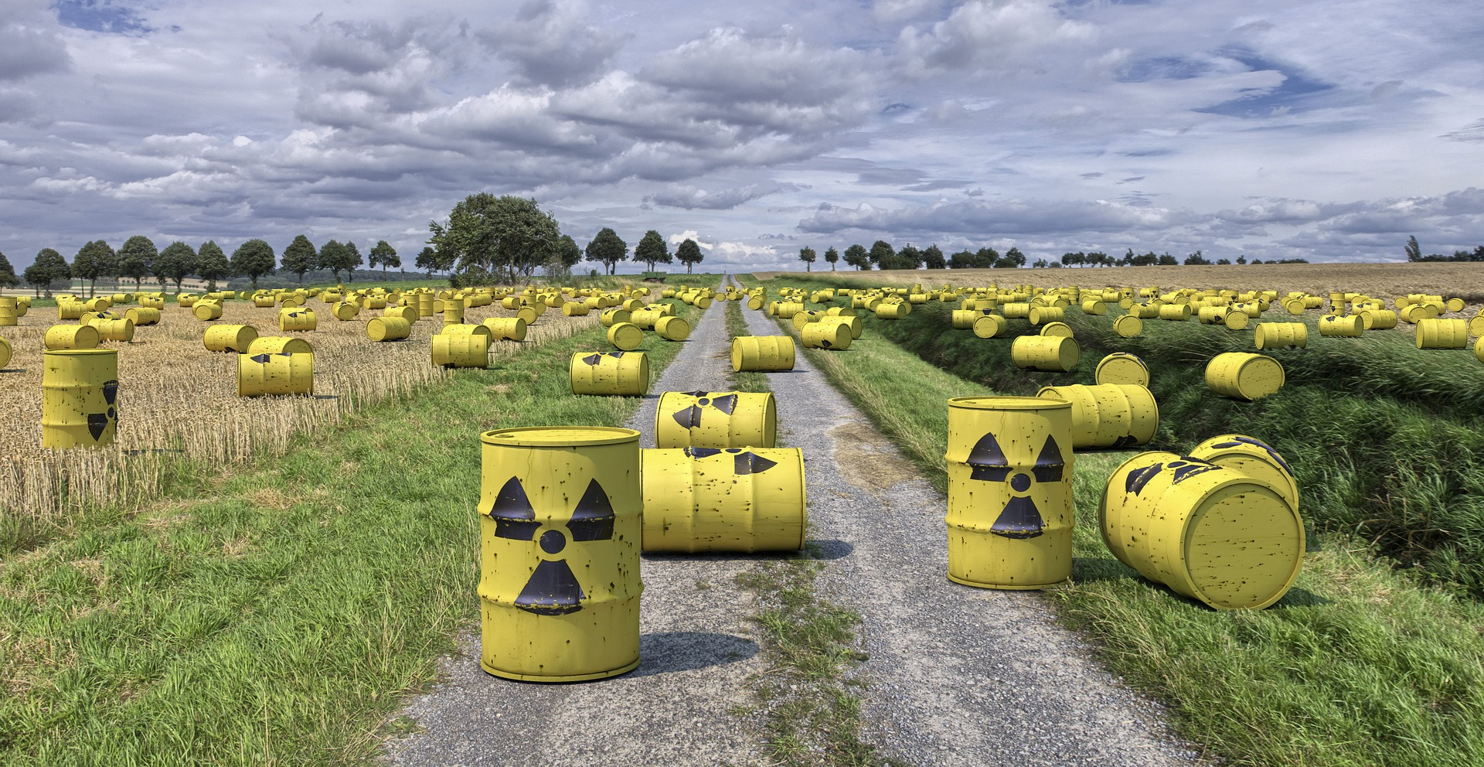
Introduction
Horrible Waste Management – Nuclear Waste
"Nuclear waste" by aaadrian365 is licensed with CC BY-NC 2.0. To view a copy of this license, visit https://creativecommons.org/licenses/by-nc/2.0/

Slide 19
Introduction
Horrible Waste Management – Nuclear Waste
→ 40,000 generations will have to live with the waste
→ 2 generations profited from cheap nuclear energy
→ 40,000 generation will have to live with the waste
https://www.spiegel.de/wissenschaft/technik/endlager-suche-was-wie-viel-und-wohin-damit-die-deutsche-atommuell-bilanz-a-7a153ba3-029a-4e55-adaf-3312b7427d9e

Slide 20
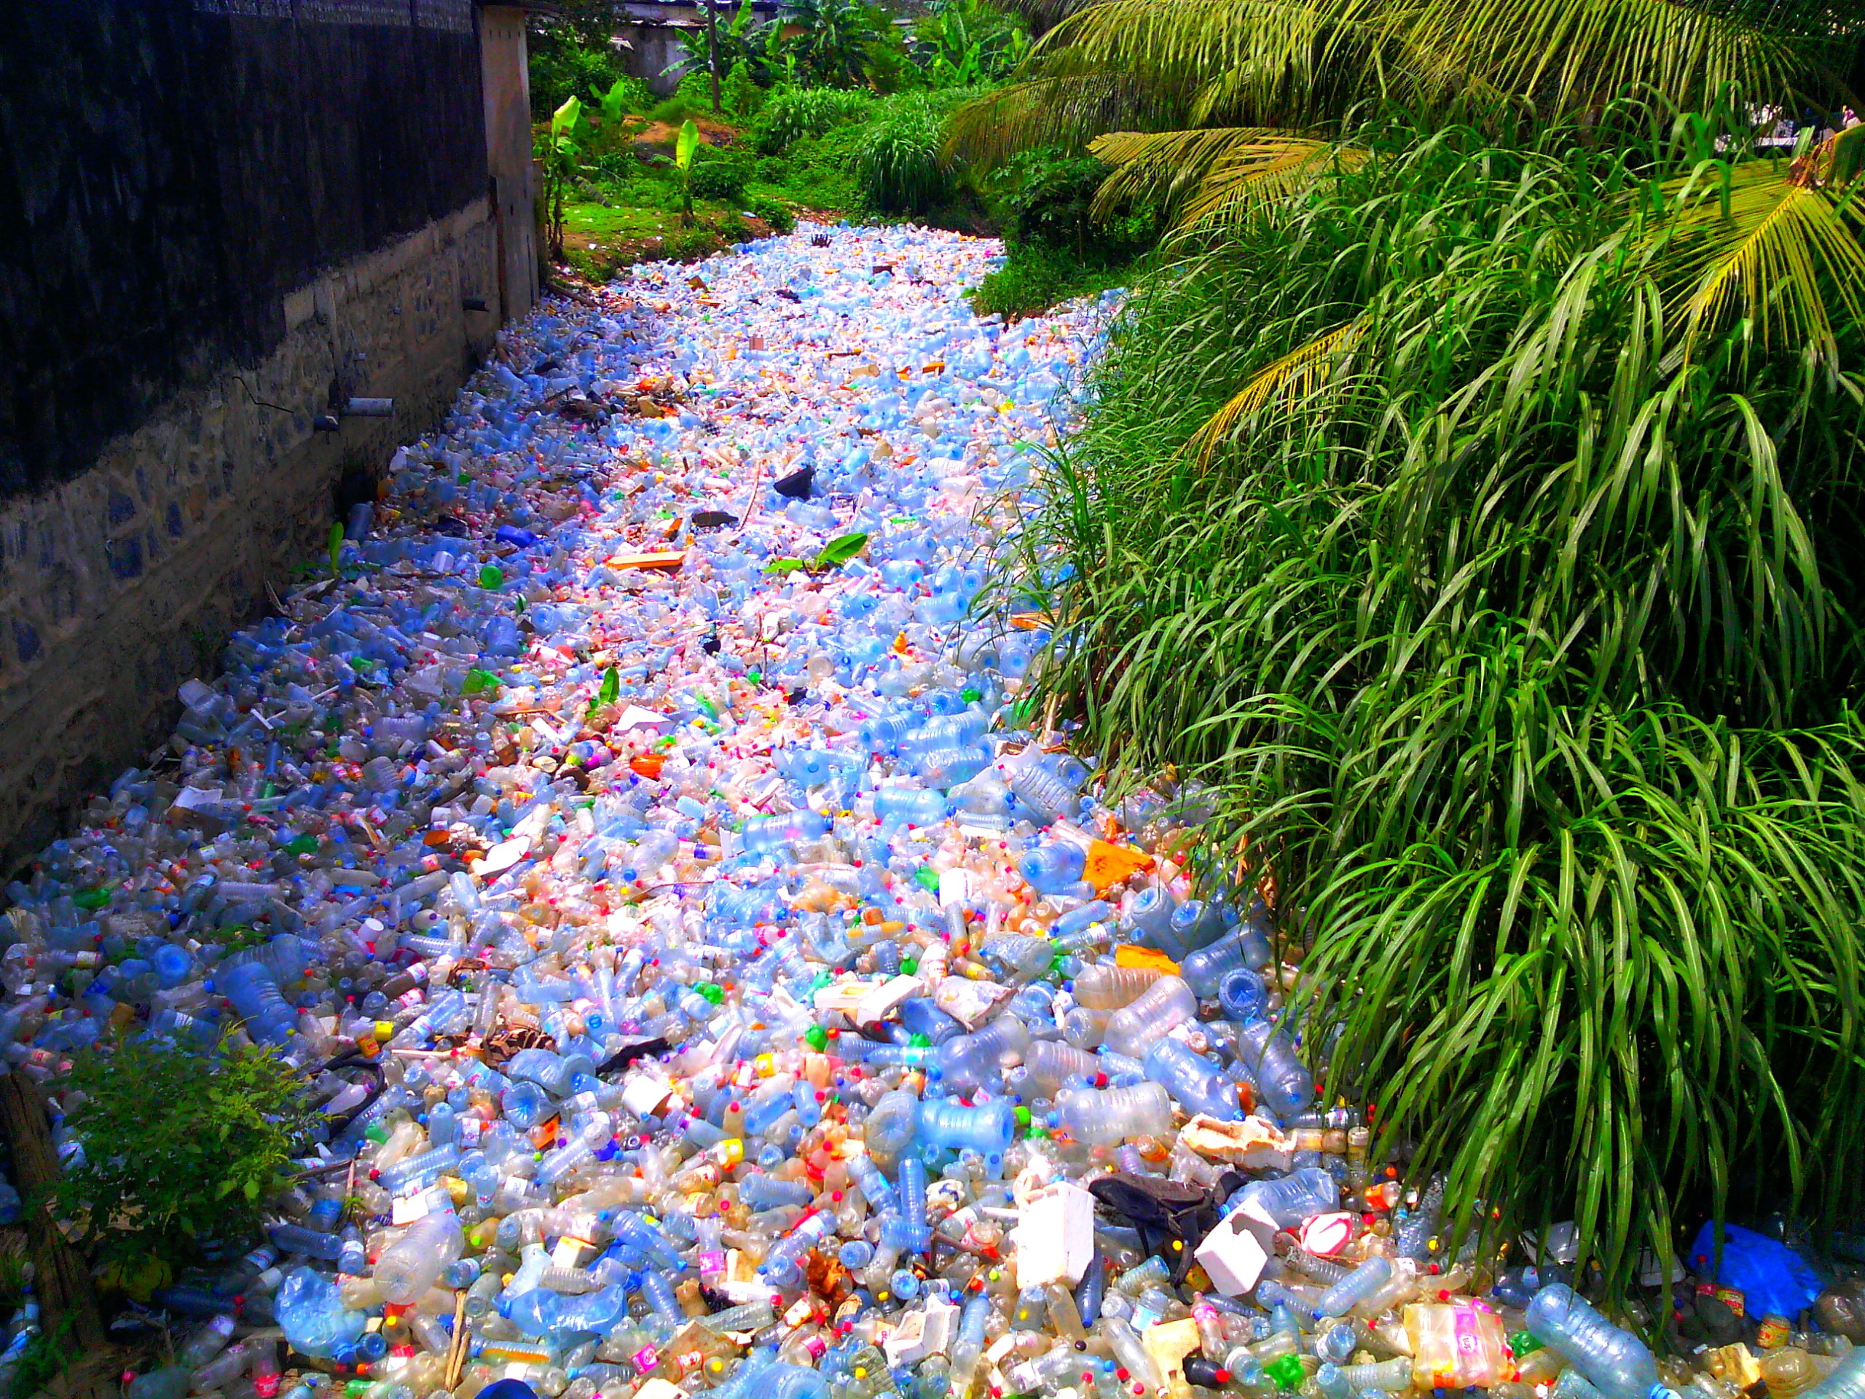
Introduction
Horrible Waste Management – Plastic
"Pollution Plastique" by Mouenthias is licensed with CC BY-SA 4.0. To view a copy of this license, visit https://creativecommons.org/licenses/by-sa/4.0/

Slide 21
Introduction
The Limits to Recycling
Recycling often requires a lot of energy
Some materials cannot be recycled at all (yet)
Impurities are challenging
Often requires a lot of manual labor
Recycled material often with lower quality than input material
False sense of safety!
I am not saying you should stop recycling!
→ Recycling is great but it is better to make sure that we do not have to recycle anything.
→ Buying less (e.g., only the essentials) is way more effective.
“We buy things we don't need, to impress people we don't like.” - Tyler Durden / Chuck Palahniuk

Slide 22
Waste = Inefficiency

Slide 23
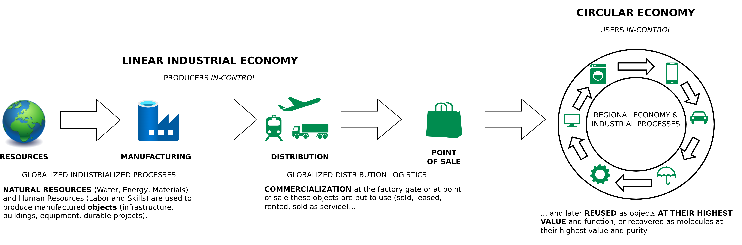
Introduction
From Linear to Circular
Image adapted from: Walter R. Stahel (2019) – The Circular Economy: A User’s Guide.

Slide 24
Introduction
Linear Economy – Main Challenges
Environmental pollution / waste
Waste of resources
→ Just recycling is not gonna do it
Therefore:
Consume less
Make stuff last longer
Maximize resource utilization

Slide 25
Introduction
Linear Economy – Main Challenges
Environmental pollution / waste
Waste of resources
→ Just recycling is not gonna do it
Therefore:
Consume less
Make stuff last longer
Maximize resource utilization

Slide 26
The Circular economy

Slide 27
Circular Economy
Center for Digital Technologies (DIGIT) (2022) – https://www.digit-research.de/fileadmin/DIGIT/Presse_und_News/Downloads/Grafikpaket_Reallabor_DCE_Kreislaufmodell_V2_ccby.zip – CC BY 4.0.

Slide 28
Circular Economy
Definition
“Conceptualizing the circular economy: An analysis of 114 definitions.”
Kirchherr, Julian, Denise Reike and Marko P. Hekkert. Resources Conservation and Recycling 127 (2017): 221-232.
https://doi.org/10.1016/J.RESCONREC.2017.09.005
Kirchherr, J., Reike, D., & Hekkert, M. (2017) – Conceptualizing the circular economy: An analysis of 114 definitions. Resources, conservation and recycling, 127, 221-232.

Slide 29
Circular Economy
Definition
“A circular economy is an industrial system that is restorative or regenerative by intention and design. It replaces the ‘end-of-life’ concept with restoration, shifts towards the use of renewable energy, eliminates the use of toxic chemicals, which impair reuse, and aims for the elimination of waste through the superior design of materials, products, systems, and, within this, business models.”
– Ellen MacArthur Foundation
https://www.ellenmacarthurfoundation.org/assets/downloads/publications/Ellen-MacArthur-Foundation-Towards-the-Circular-Economy-vol.1.pdf

Slide 30
Circular Economy
Definition
“A circular economy is an industrial system that is restorative or regenerative by intention and design. It replaces the ‘end-of-life’ concept with restoration, shifts towards the use of renewable energy, eliminates the use of toxic chemicals, which impair reuse, and aims for the elimination of waste through the superior design of materials, products, systems, and, within this, business models.”
– Ellen MacArthur Foundation
“The circular economy is a model of production and consumption, which involves sharing, leasing, reusing, repairing, refurbishing and recycling existing materials and products as long as possible. In this way, the life cycle of products is extended.”
– European Parliament
https://www.ellenmacarthurfoundation.org/assets/downloads/publications/Ellen-MacArthur-Foundation-Towards-the-Circular-Economy-vol.1.pdf
https://www.europarl.europa.eu/news/en/headlines/economy/20151201STO05603/circular-economy-definition-importance-and-benefts
Notes:
30

Slide 31
Circular (Industrial) Economy
Definition
“The circular industrial economy manages stocks of manufactured assets, such as infrastructure, buildings, vehicles, equipment and consumer goods, to maintain their value and utility as high as possible for as long as possible; and stocks of resources at their highest purity and value.”
Walter R. Stahel (2019) – The Circular Economy: A User’s Guide.

Slide 32
Circular Economy
Sustainability – Definition
„Development that meets the needs of the present without compromising the ability of future generations to meet their own needs.”
Report of the World Commission on Environment and Development: Our Common Future (1987) – http://www.un-documents.net/our-common-future.pdf

Slide 33
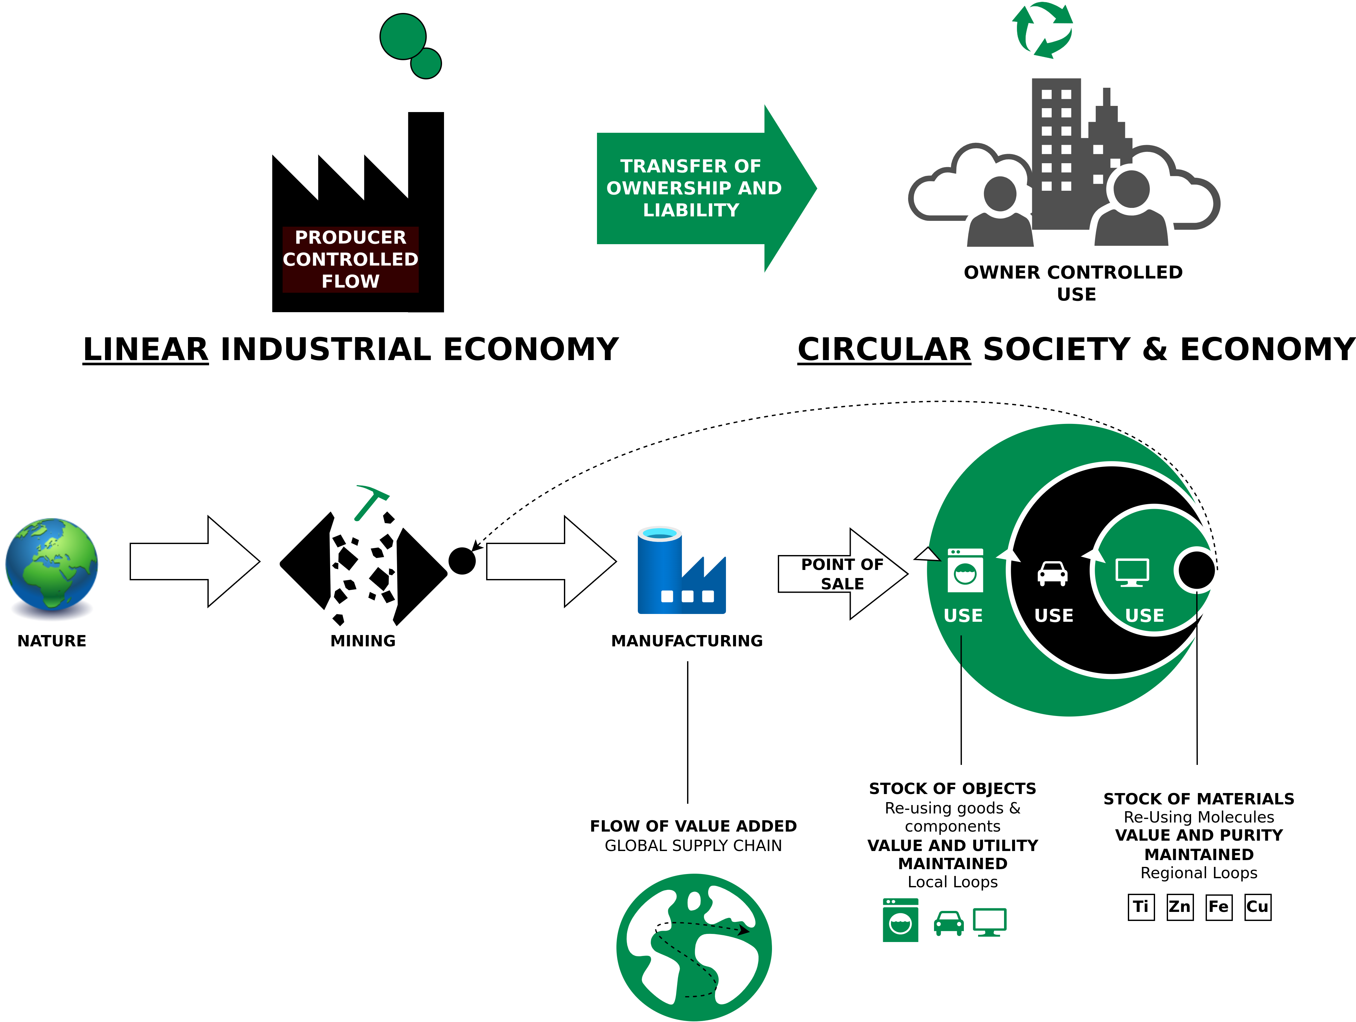
Circular Economy
Characteristics
Image adapted from: Walter R. Stahel (2019) – The Circular Economy: A User’s Guide.

Slide 34
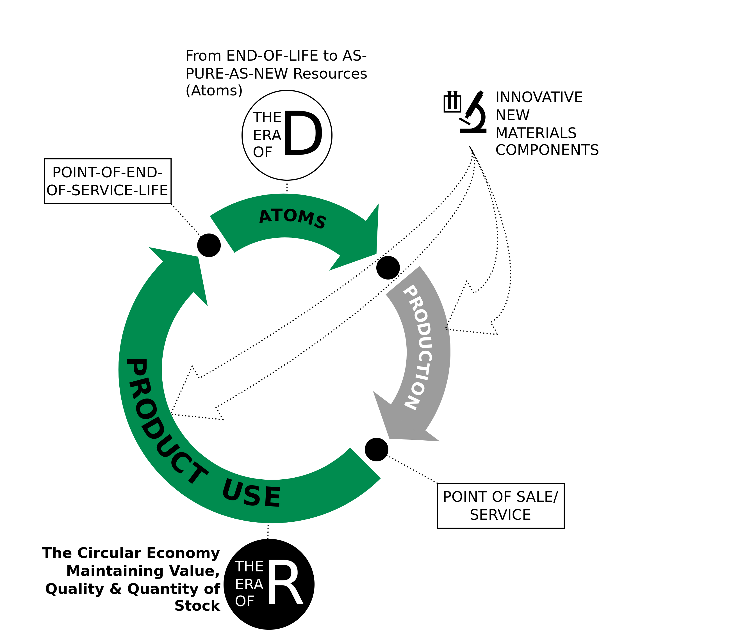
Circular Economy
The Era of R
Techno-commercial strategies to keep goods and components at highest value level through:
Reuse
Repair
Remarket
Remanufacture
Re-refine
Reprogramme goods
Image adapted from Walter R. Stahel (2019) – The Circular Economy: A User’s Guide.

Slide 35
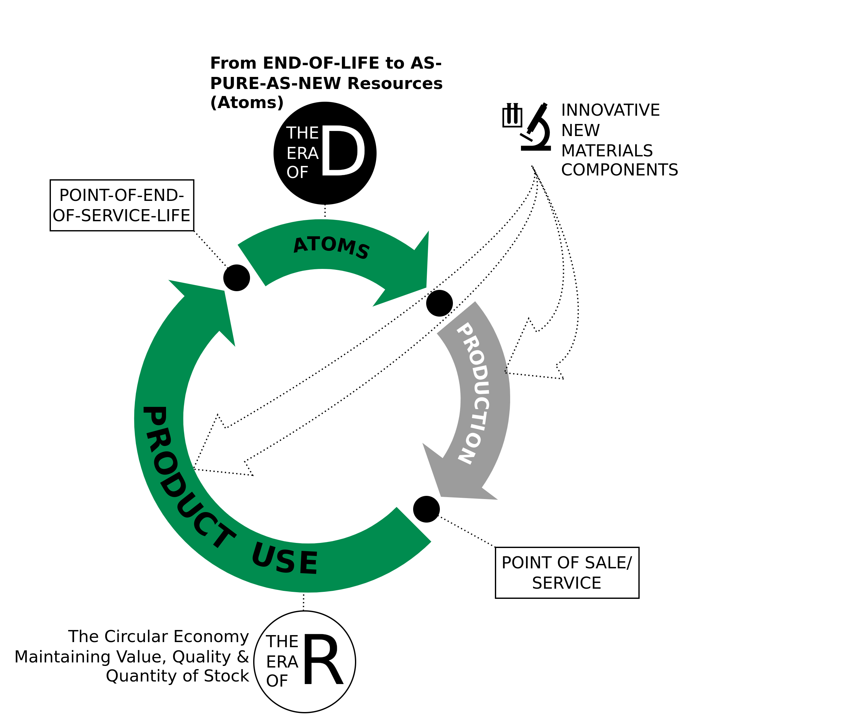
Circular Economy
The Era of D
Technologies and actions to recover atoms and molecules at highest quality (purity and value) level as pure as virgin:
De-polymerise
De-alloy
De-laminate
De-vulcanise
De-coat materials
De-construct high-rise buildings and major infrastructure
Image adapted from Walter R. Stahel (2019) – The Circular Economy: A User’s Guide.

Slide 36
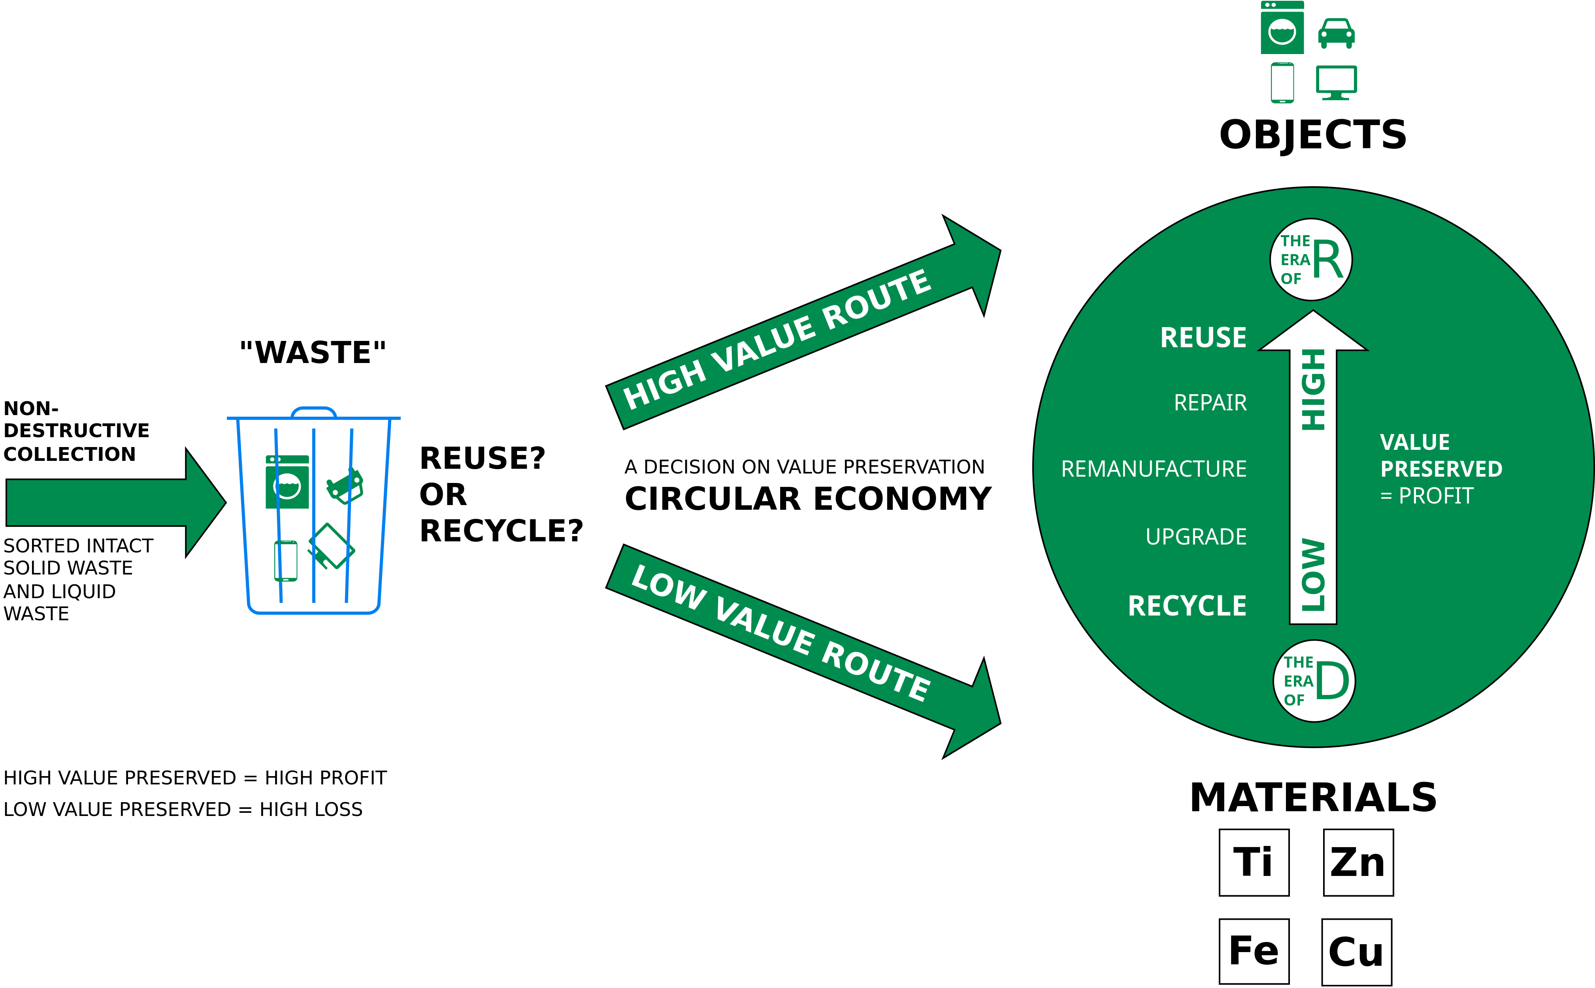
Circular Economy
End-of-Life – Reuse or Recycle?
Image adapted from Walter R. Stahel (2019) – The Circular Economy: A User’s Guide.

Slide 37
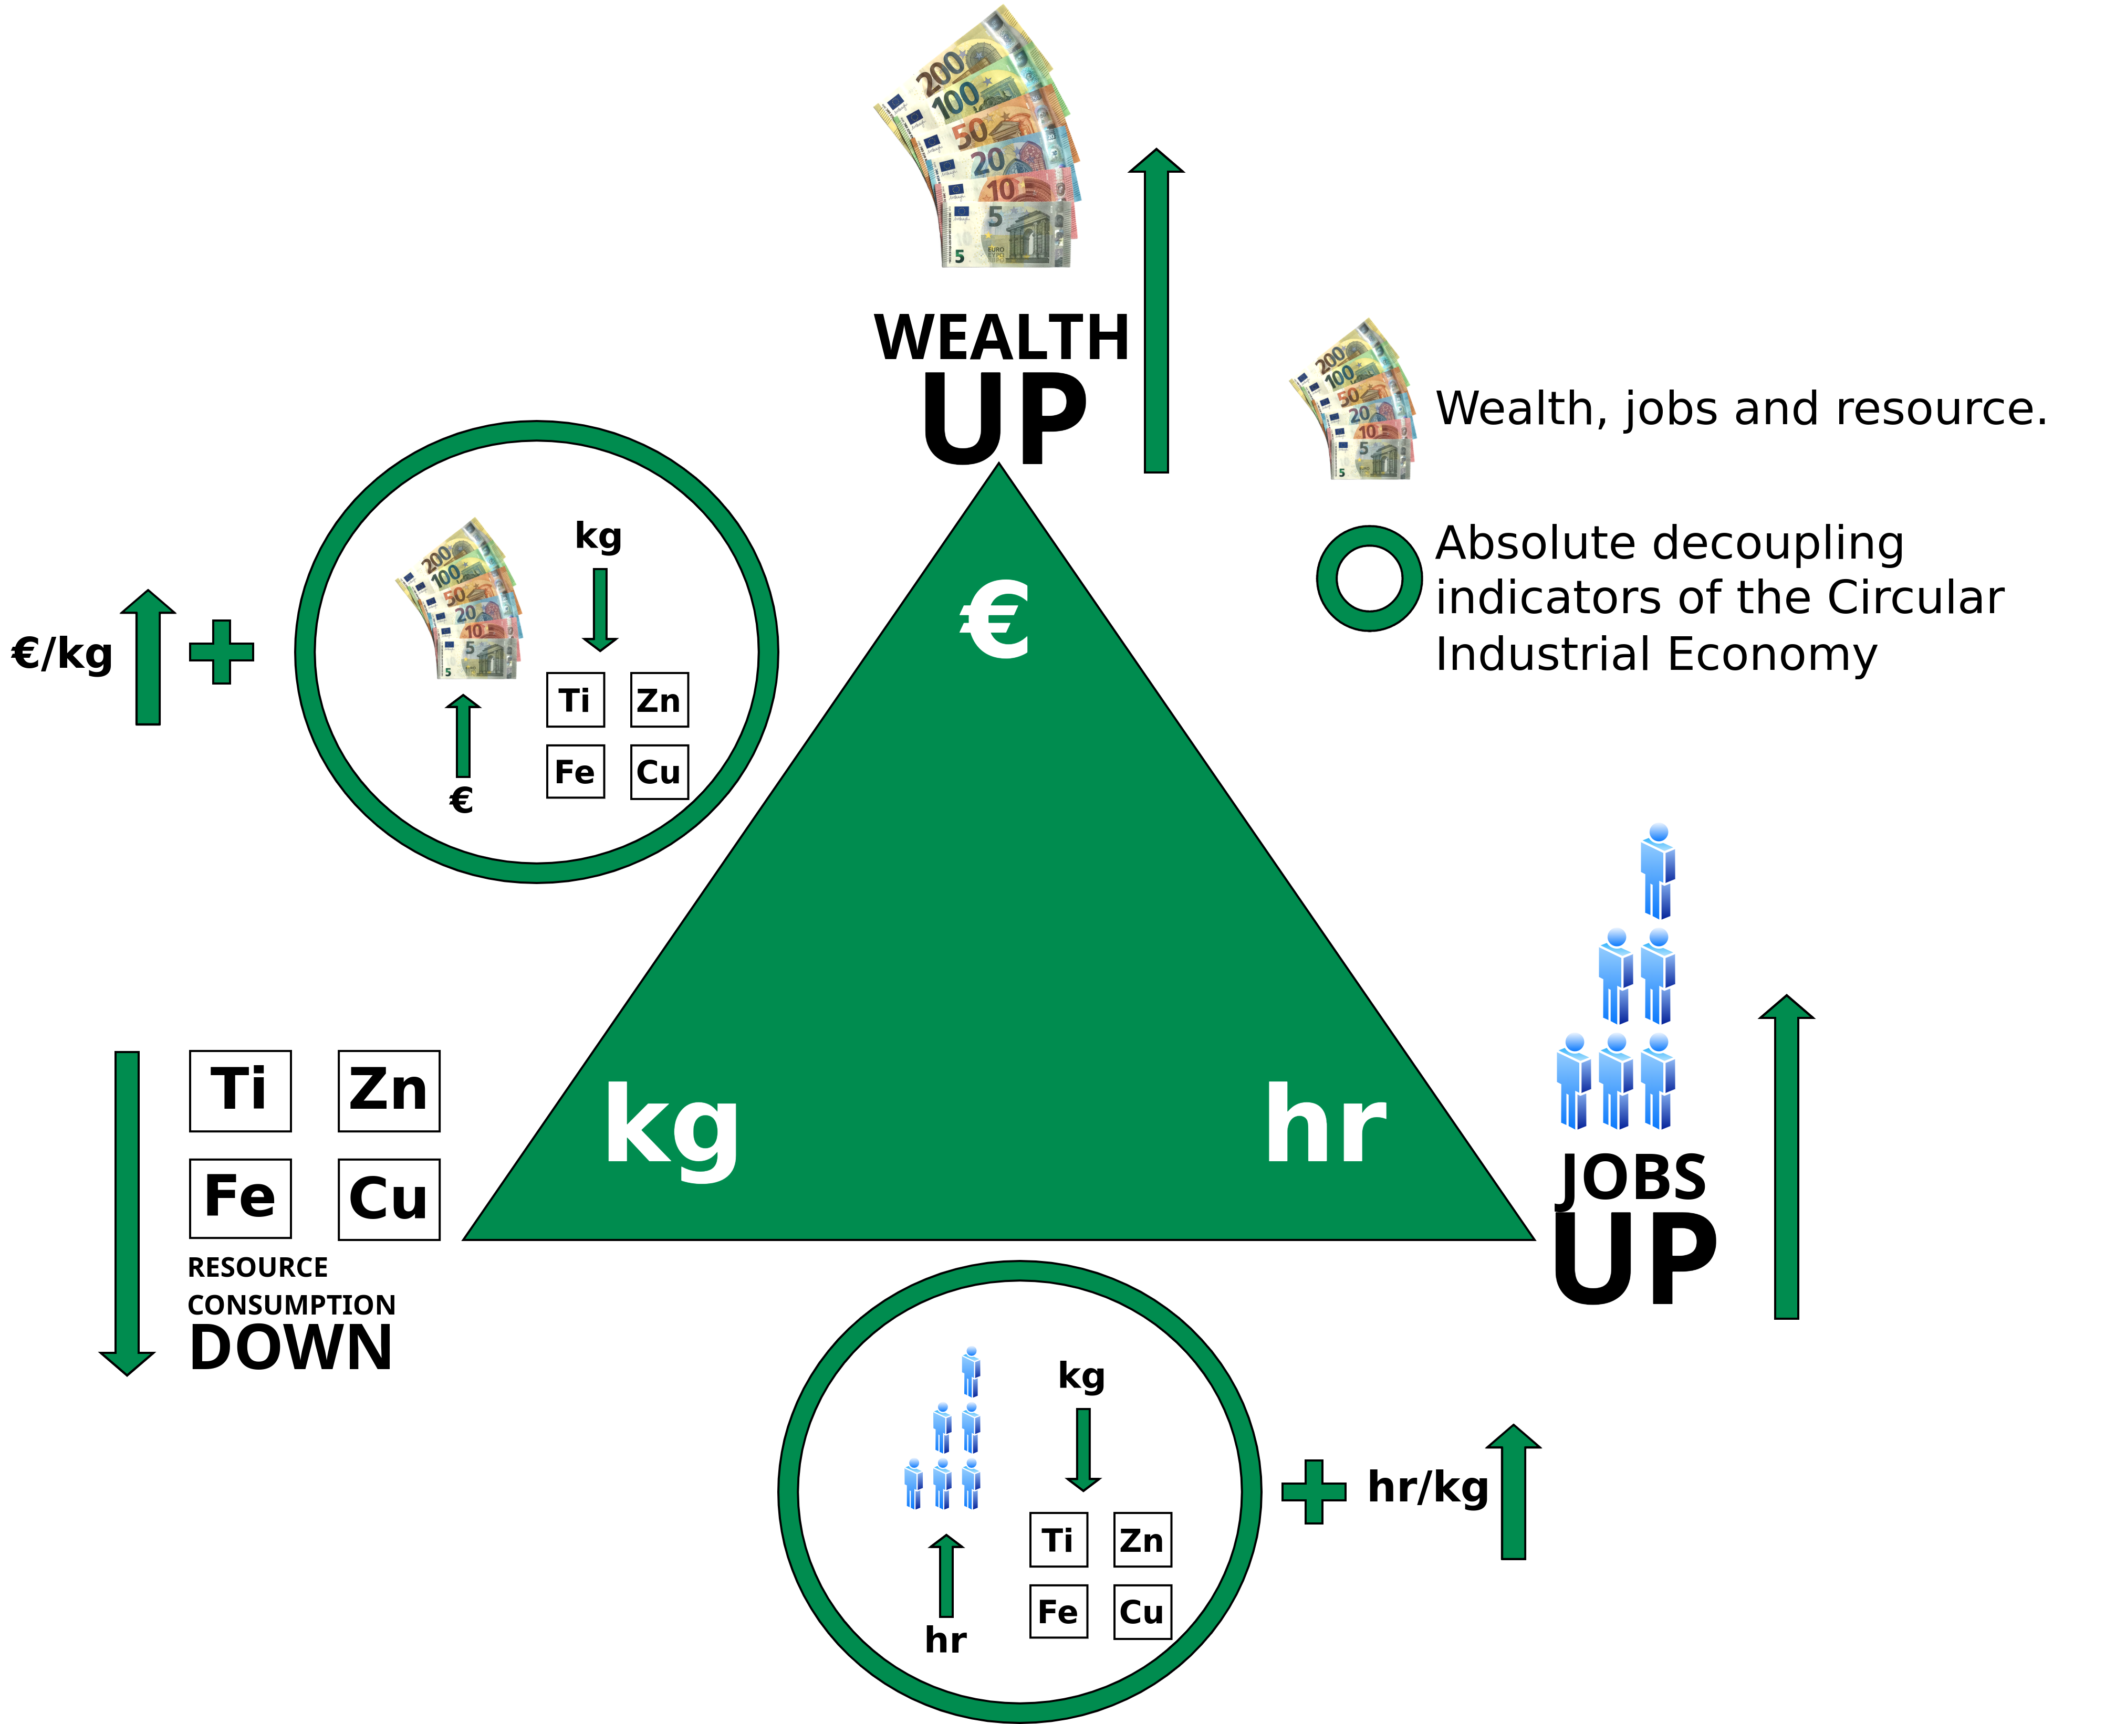
Circular Economy
More Wealth/Jobs From Less Resource Consumption
Linear Economy: Low hr/kg (labor input per weight) ratios, coherent with mass production in highly mechanized processes, and low to medium €/kg (value per weight) ratios, in a range from basic materials like cement to smart goods like USB memory sticks
Circular Economy: Higher hr/kg and €/kg ratios for reuse, remanufacture and selling performance (goods as a service), in a group with new technologies, such as life sciences and nanotechnologies, which by nature produce dematerialized objects.
Image adapted from Walter R. Stahel (2019) – The Circular Economy: A User’s Guide.

Slide 38
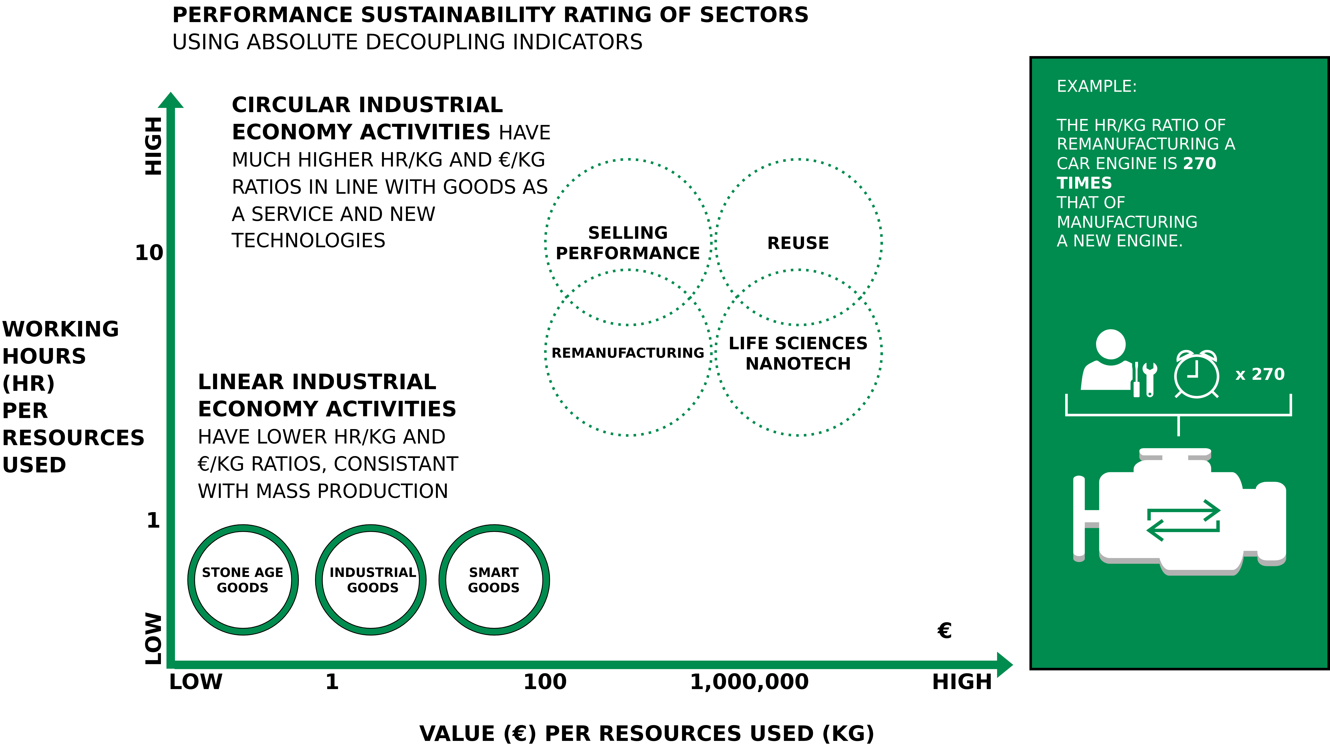
Circular Economy
New Engine vs. Remanufacturing A Car Engine
Image adapted from Walter R. Stahel (2019) – The Circular Economy: A User’s Guide.

Slide 39
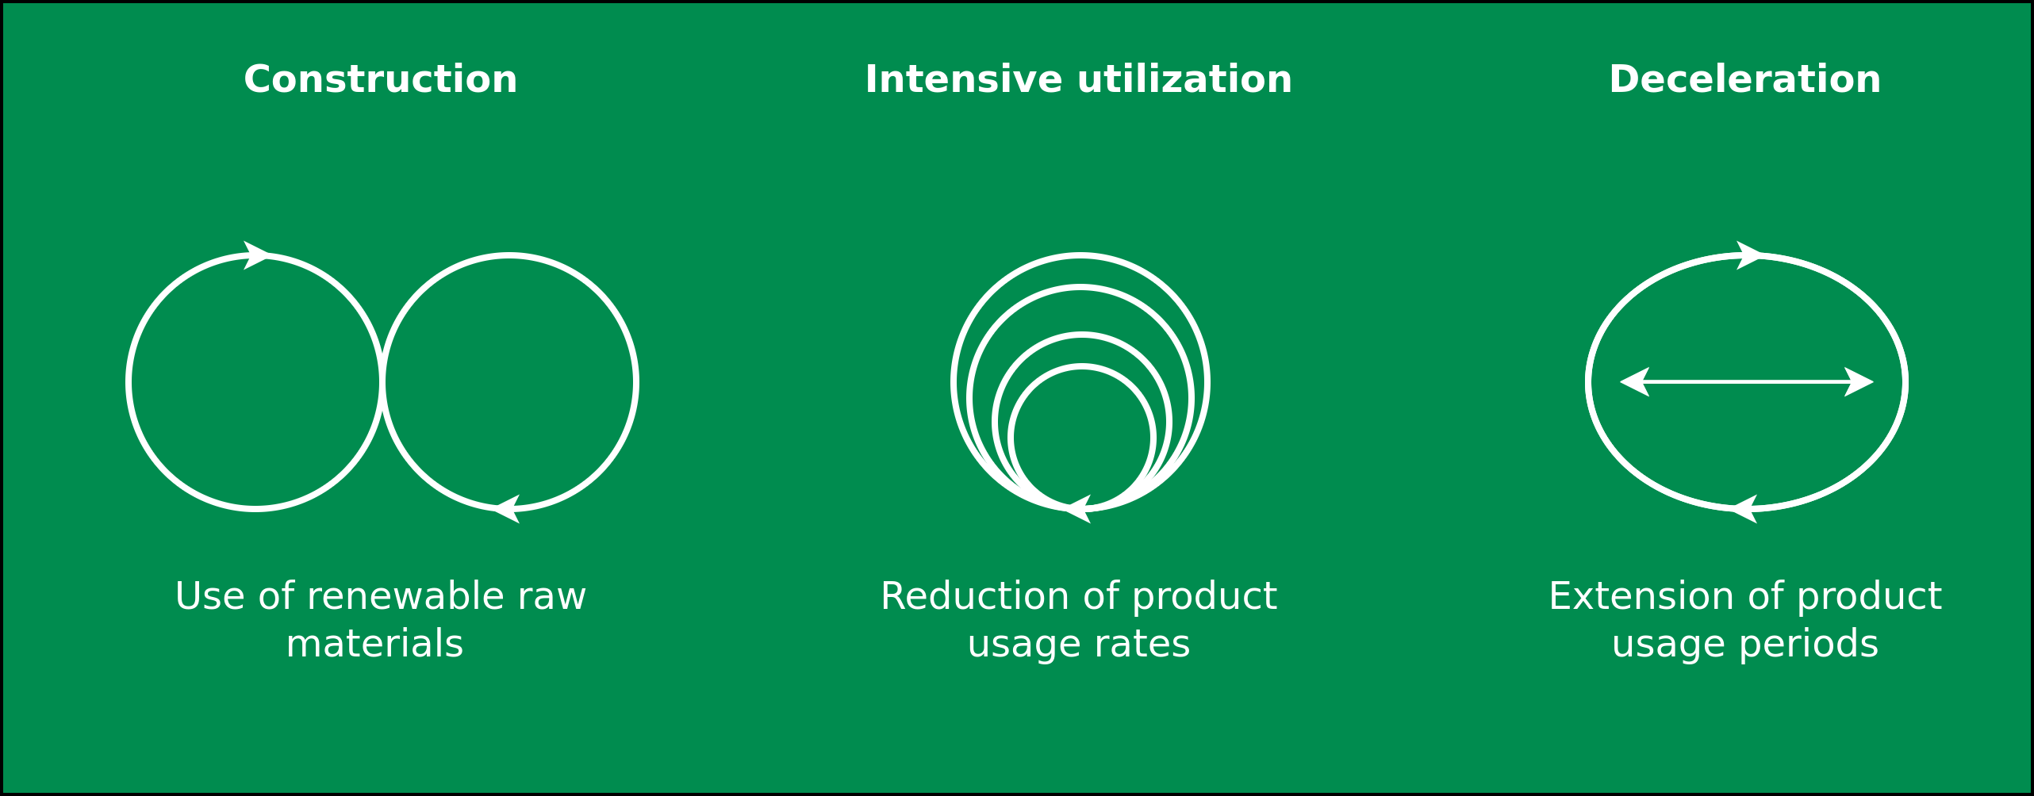
Circular Economy
Business Model Characteristics
Image adapted from: M. Jaeger-Erben, F. Hofmann (2019) – Kreislaufwirtschaft - Ein Ausweg aus der sozial-ökologischen Krise? – Link.

Slide 40
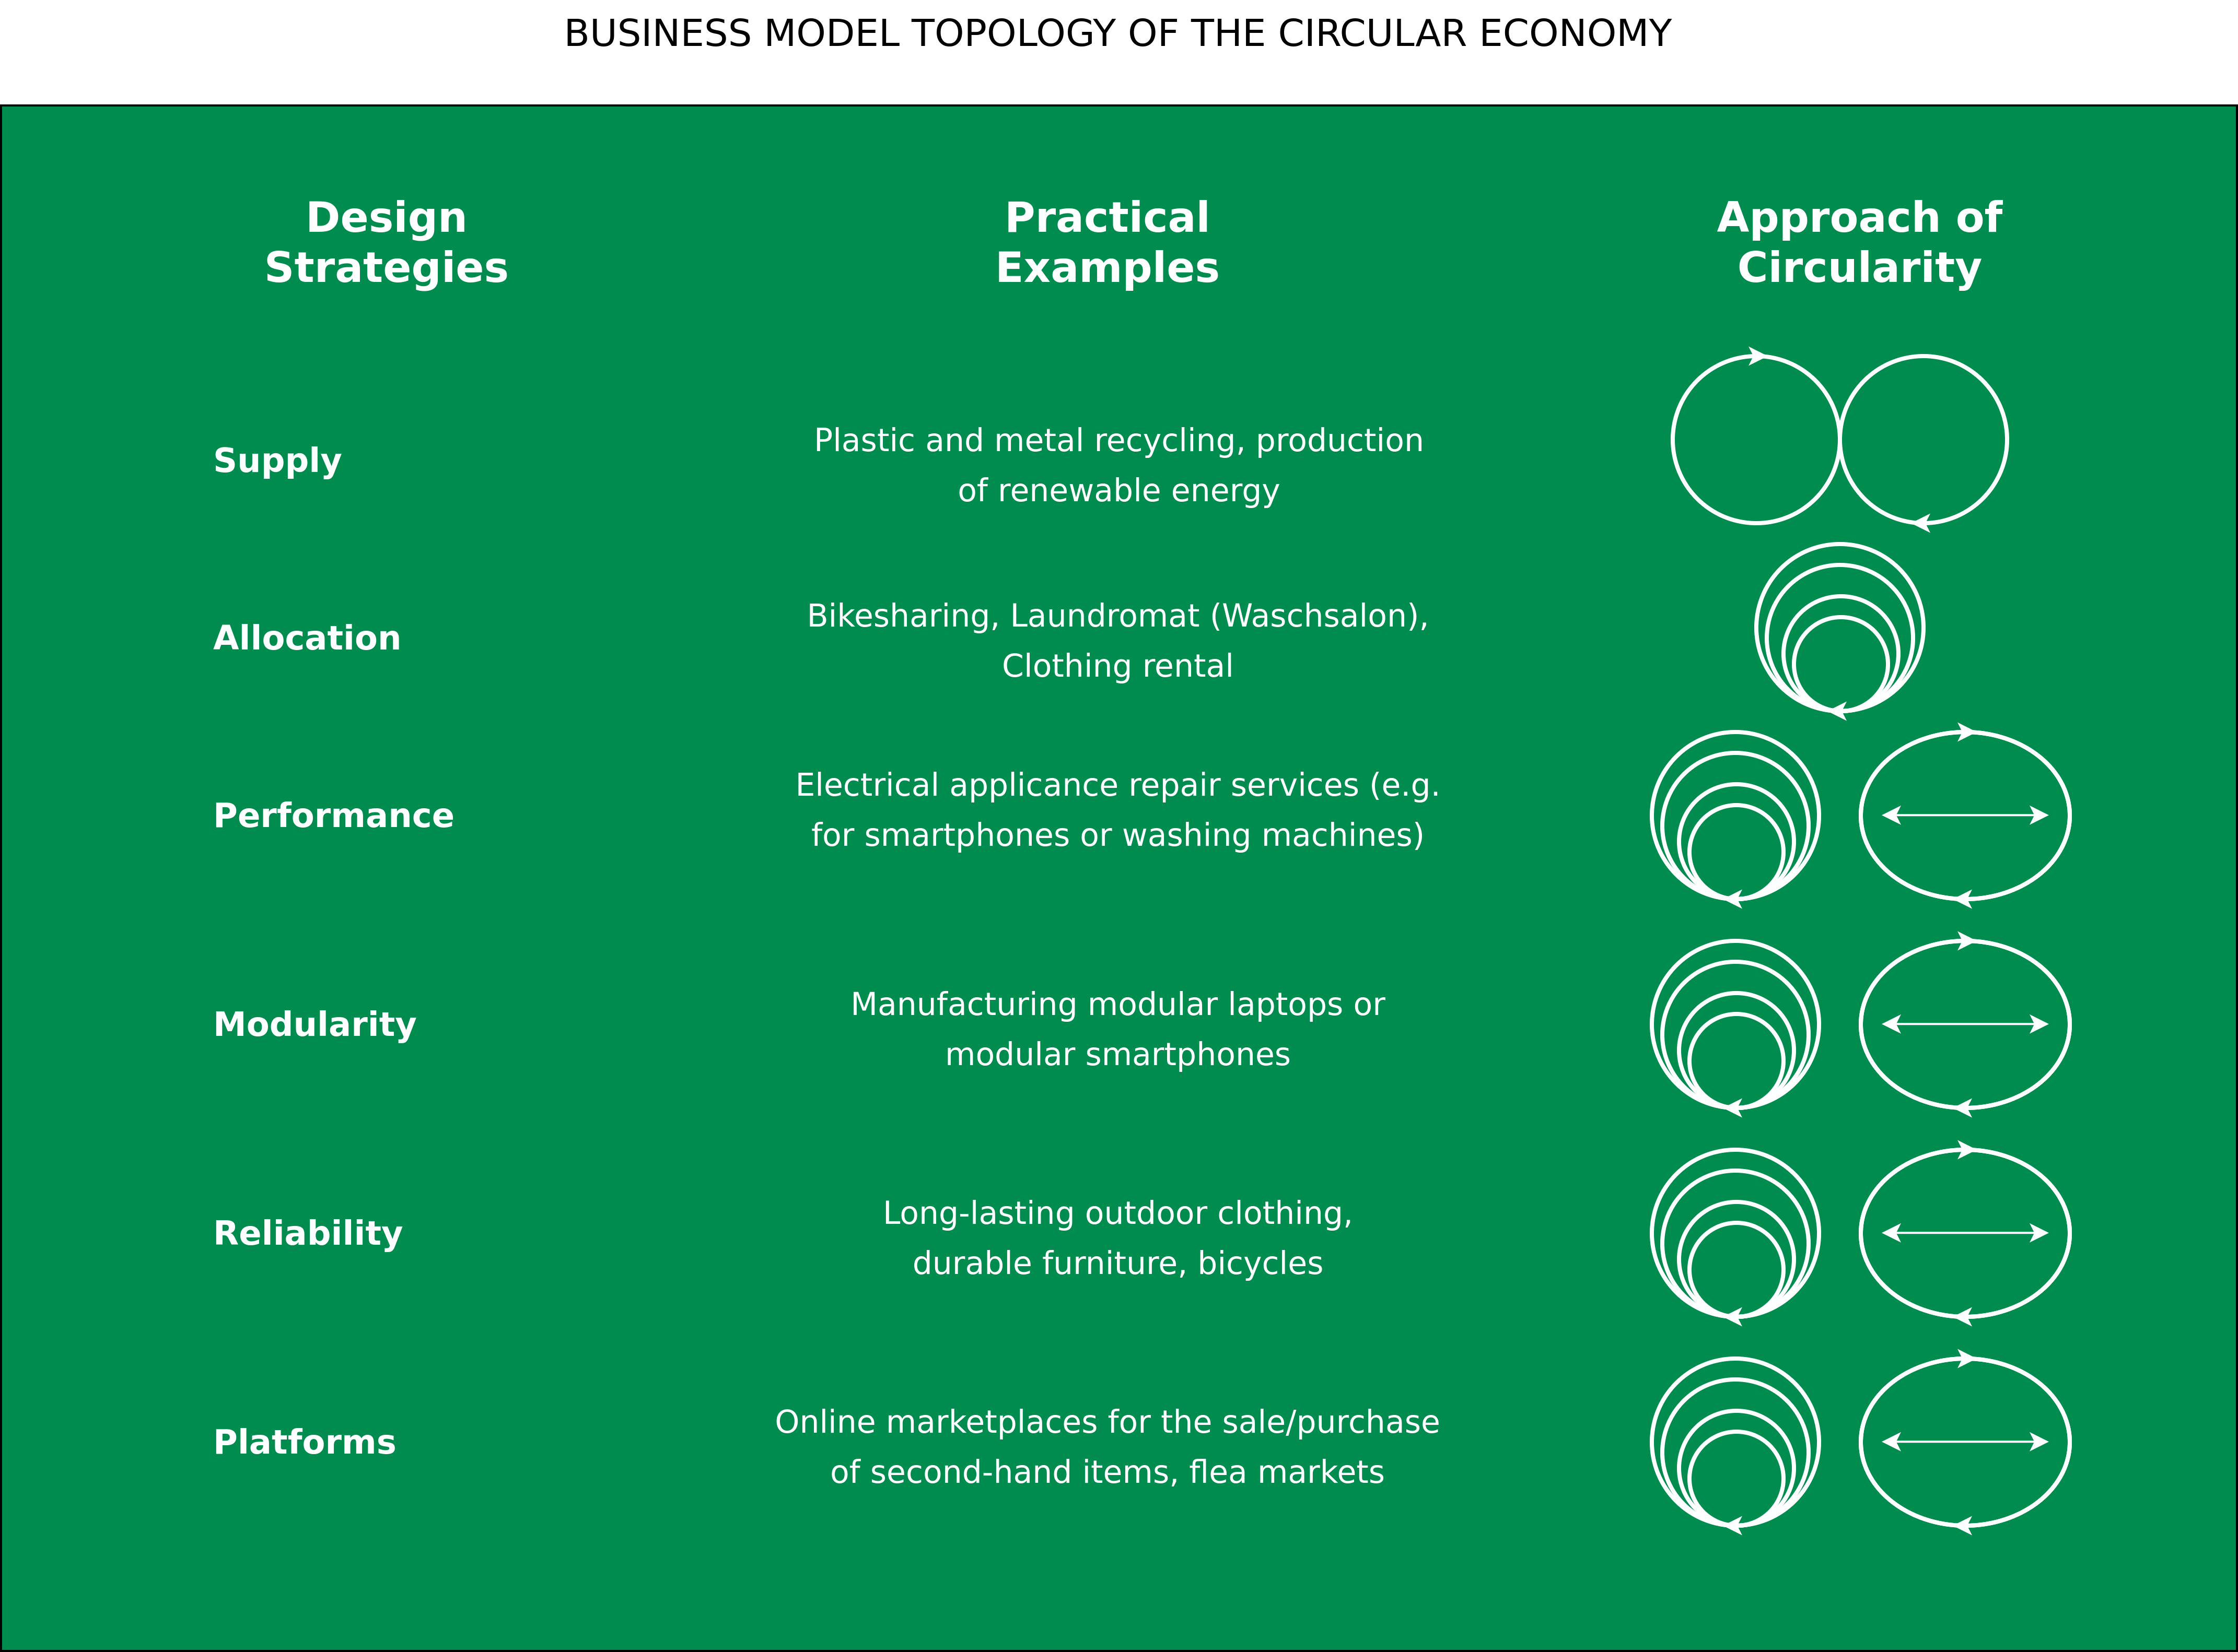
Circular Economy
Image adapted from: M. Jaeger-Erben, F. Hofmann (2019) – Kreislaufwirtschaft - Ein Ausweg aus der sozial-ökologischen Krise? – Link.

Slide 41
Performance Economy

Slide 42

Performance Economy
Image adapted from Walter R. Stahel (2019) – The Circular Economy: A User’s Guide.

Slide 43
Performance Economy – Definition
„The Performance Economy sells results instead of objects. Its economic actors may be manufacturers of durable objects or fleet managers operating them. In both cases, they sell the use of these objects as a service over the longest possible period of time and maximize their profits by exploiting both efficiency and sufficiency solutions. “
Walter R. Stahel (2019) – The Circular Economy: A User’s Guide.

Slide 44
Performance Economy – Most sustainable CE business model?
Stahel argues:
“The Performance Economy of selling goods and molecules as a service, function guarantees or results and performance, is the most sustainable business model of the circular industrial economy because by internalising the costs of product liability, of risk and waste, it offers manufacturers a strong financial incentive to prevent losses and waste.”
Walter R. Stahel (2019) – The Circular Economy: A User’s Guide.

Slide 45
Performance Economy – Most sustainable CE business model?
Stahel argues:
“The Performance Economy of selling goods and molecules as a service, function guarantees or results and performance, is the most sustainable business model of the circular industrial economy because by internalising the costs of product liability, of risk and waste, it offers manufacturers a strong financial incentive to prevent losses and waste.”
“It maximises the profit potential by exploiting sufficiency, efficiency and systems solutions.”
Walter R. Stahel (2019) – The Circular Economy: A User’s Guide.

Slide 46
Performance Economy – Most sustainable CE business model?
Stahel argues:
“The Performance Economy of selling goods and molecules as a service, function guarantees or results and performance, is the most sustainable business model of the circular industrial economy because by internalising the costs of product liability, of risk and waste, it offers manufacturers a strong financial incentive to prevent losses and waste.”
“It maximises the profit potential by exploiting sufficiency, efficiency and systems solutions.”
“In addition, by maintaining the ownership of objects and embodied resources, it creates long-term corporate and national resource security at low cost.”
Walter R. Stahel (2019) – The Circular Economy: A User’s Guide.

Slide 47
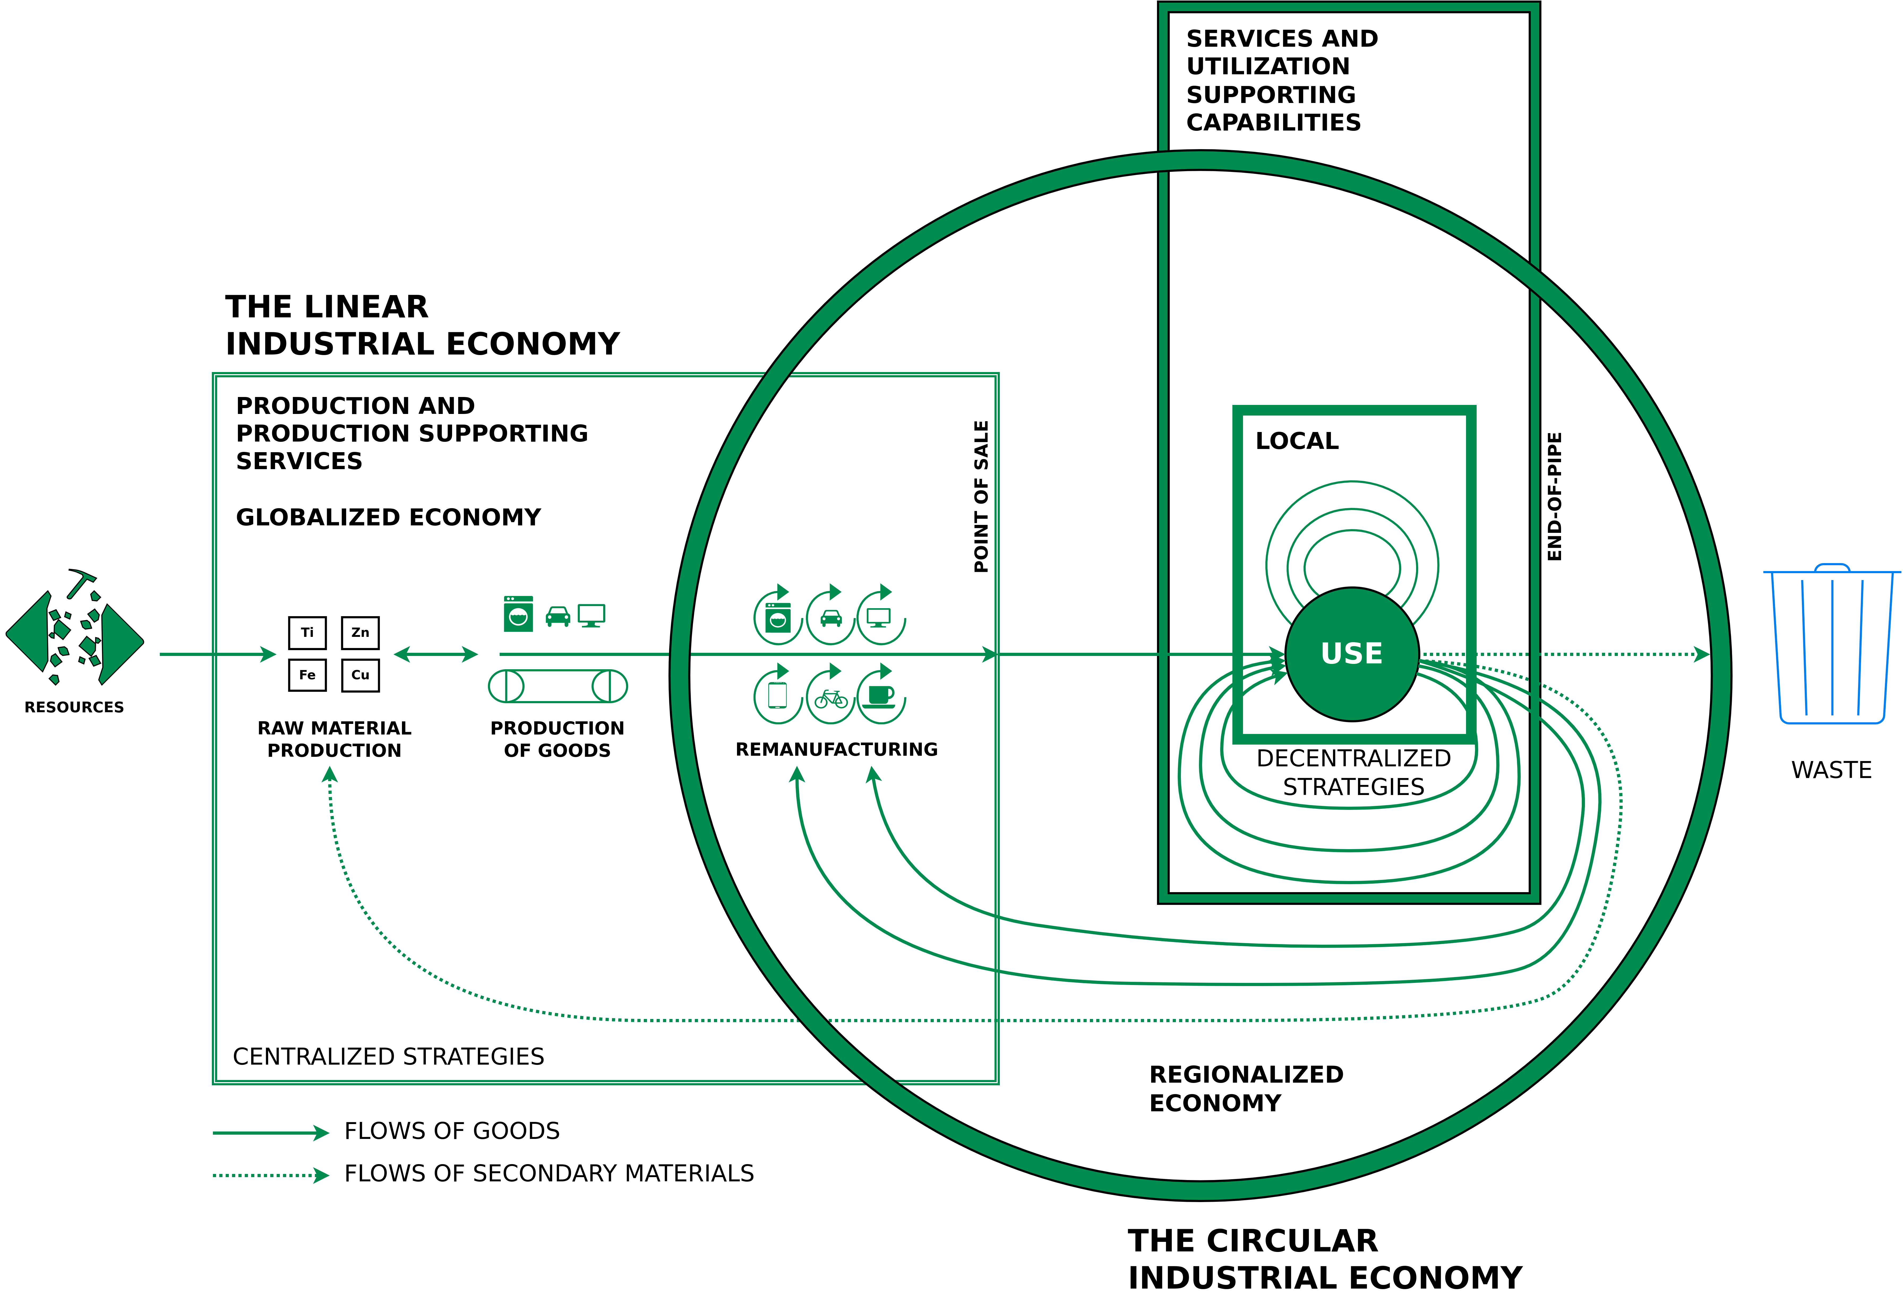
Situating the LIE, the CIE and the PE
Circle: Managing the utilisation or use phase of stocks of manufactured objects and their components, by maintaining the value and quality of infrastructure, buildings, investment goods, equipment and durable consumer goods in a local or regional economy
Small square: Local use-focused PE
Big square: Flows of used materials returning to the raw material producer to recover molecules and atoms in a globalised economy
Walter R. Stahel (2019) – The Circular Economy: A User’s Guide.

Slide 48
Situating the LIE, the CIE and the PE
Circle: Managing the utilisation or use phase of stocks of manufactured objects and their components, by maintaining the value and quality of infrastructure, buildings, investment goods, equipment and durable consumer goods in a local or regional economy
Small square: Local use-focused PE
Big square: Flows of used materials returning to the raw material producer to recover molecules and atoms in a globalised economy
Walter R. Stahel (2019) – The Circular Economy: A User’s Guide.

Slide 49
Situating the LIE, the CIE and the PE
Circle: Managing the utilisation or use phase of stocks of manufactured objects and their components, by maintaining the value and quality of infrastructure, buildings, investment goods, equipment and durable consumer goods in a local or regional economy
Small square: Local use-focused PE
Big square: Flows of used materials returning to the raw material producer to recover molecules and atoms in a globalised economy
Walter R. Stahel (2019) – The Circular Economy: A User’s Guide.

Slide 50
Conclusion

Slide 51
Conclusion
Linear Economy (LE) → “Take – make – dispose”
Circular Economy (CE) → Maintain value and utility as high as possible for as long as possible
Performance Economy → Sell results instead of objects

Slide 52
Exercise E07

Slide 53
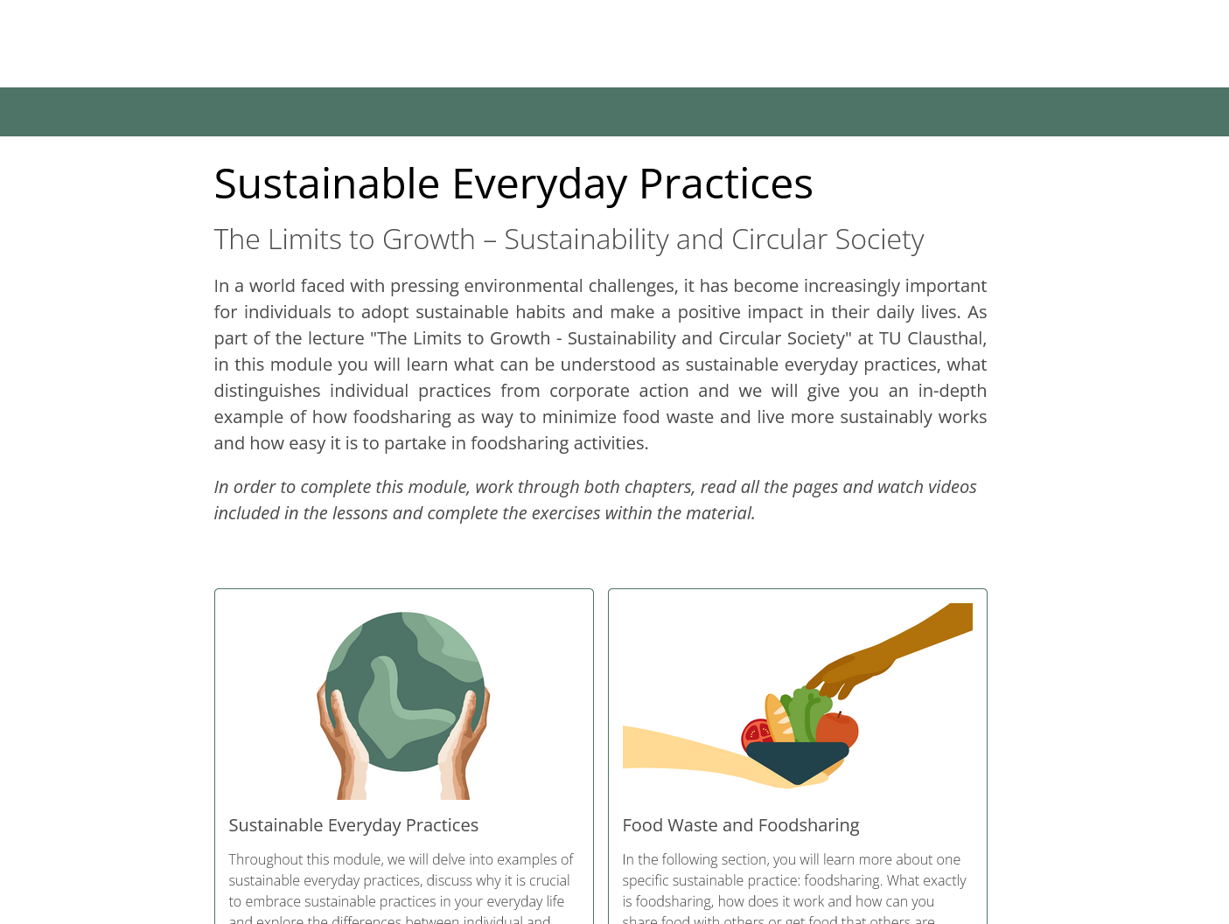
Exercise E07
Evaluating the MOOC Content
As we have explained in the beginning of the lecture, we are currently working on developing asynchronous and interactive learning content for the “Limits to Growth” lecture.

Slide 54
Exercise E07
Evaluating the MOOC Content
As we have explained in the beginning of the lecture, we are currently working on developing asynchronous and interactive learning content for the “Limits to Growth” lecture.
Work through the whole lesson on “Sustainable Everyday Practices and Foodsharing”
Go to the website (Link).
Read all the texts, watch the videos and answers the assessment questions.
2. After you completed the online lesson, please answer the following questions:
What did you like about the MOOC content?
Which parts of the MOOC content did you not like?
Give up to three ways this online learning material could been improved.

Slide 55
Additional Resources
Walter R. Stahel (2019) – The Circular Economy: A User's Guide
Website of the Ellen MacArthur Foundation – Link

Slide 56
Questions?

